Slide 1

WELCOME

Slide 2

A
Major project on
“Mood Based Music System”
Group Members : -
1. Durgesh Joshi (1718000024). 2. Vaibhav More (1718000022). 3. Athang More (1818000068). 4. Nikhil Mane (1818000013).
5. Om Kale(1918000080) Class: - TYCO Guided By: - Prof. S.K.Thorat Subject: - Capstone Project Planning(22058).
Gokhale Education Society’s
Sir. DR. M. S Gosavi Polytechnic Institute, Nashik
Year: - 2020-21

Slide 3
Planning Process
Step1-
First we have collect all the necessary requirements of our project such as installation of python. then install the particular libraries we wants. such as OpenCV, time, global modules any many other modules.t hen download equivalent dataset of our project.
Step2-
After gathering all the necessary information we draw the rough outputs of our project means after creating our project how project is actually looks like.
Step3-
After we see our project design in front of our self now we are going to start creating our actuall project. and we are making our project as per our design means there is less probabilities to our project is getting failed.
Step4-
After creating our project as per our design now it's going through the testing phase and we will check all the test cases and where our test cases is passes and where it's is fail so that after test cases is failed we make more improvement in our project and tried to pass all the test cases.
1

Slide 4
Conti..
Step5-
Firstly test the model separately because we want to found the actual error with specific model. if we couldn't do this or check all the models in group then we will confuse that where will actually error is arrived.
Step6-
After testing if any changes occur or any model failed then we will do the changes in our project and same testing will occur again for the specific model because while changing the model or code the remaining code are not changing means after retesting the model those previously model whose pass the test cases the new model is not affected to the previous all the models and all test cases will be pass. and there will no issue with previously passed models.
Step7-
After any updation in project debug the program and test the program regularly because after updation we will check that no error will rise into our system
2

Slide 5
Implementation phase
Phase1-
First we learn the different types of module which is needed for our project. like OpenCV, time, globe etc.
Phase2-
After learning all the required modules we actually started the work on our project. first using OpenCV we successfully detect a real time face of ourself.
Phase3-
After detecting a face we found that the deepface predefined module is already train to detect human face as well as there emotion. after we known that the predefined module is already implemented then why we make our code complicated.
Phase4-
Now we decide to go with deepface module because for using deepface module our 50 to 60% project is being ready. and we take less memory and less line of code to implement our project. But after take some study about deepface module that how to implement module and how to run it. now we are going to actually implement deepface module
3

Slide 6
Conti..
Phase5-
But after implementing deepface module we saw that our system camera is to much lagging.so for solving the issue we take some study about the deepface module. after taking some study we understood that the deepface module is take too much memory to execute. we implement deepface module in all our system and saw the same result that everyone is getting same issue after implementing and running the module our all system webcam is starting lagging.so we take another research about that module because when we run deepface module in 4gb ram system and 8gb ram system we found same result.no ones system is supported to the deepface face library.
Phase6-
But after research we found the easy way to complete our project we need deepface module.so for solving issue we saw some videos about that model and understood that the Google Collab is one of the software which handles that type of issue. after understanding we shift our project into Google Collab .because we learn in Google Collab program will load and learn in Google server and output is seen into our system.
4

Slide 7
Conti..
Phase 7-
When we actually trying the code into Google Collab same issue will occur. because when we trying the code in our system we code into our server and output is shown correctly and faster. but in Google Collab code will run into Googles server and the output is shown into our system and its take too much time and same problem will occur there camera is still lagging so now deepface library and Google Collab is totally failed to implement our project.
Phase8-
Know we are stuck into the same position after taking to much effort we are coming into our starring point. know we are stuck from all sides. but we have to implement our project but how? For these we star's the new beginning and search new ideas for our project. and found a way or source that we will use to implement our project.
Phase9-
After some research we found the concept of neural networks. and we found that using neural networks we can implement our project.so for these we have started to learn about some neural networks. and we found that in neutral networks there are also 3 types of network is available.1.Artificial neural networks.2. Convolutional neural 3.Recurrent neural network now we are confused that which neural networks is correct for our project.
5

Slide 8
Conti..
Phase10-
Now for choosing a neural network for or project first we have to take some introduction about neural networks that which neural network is use for which purpose and how we we choose a neural network from these three neural networks. for this we take some overview about all neural networks.
Phase 11-
After taking some research we find that the Artificial neural network is use to solve numerical problems means using one number we can predict the new number.so this neural network is not correct for us. then we learn Recurrent neural network and we saw this neural network is not correct for us because in this neural network inputs will be learn and then output will be generated means this neural network is use in word prediction or number guessing or in Google voice assistant which save your previous activity and after entering the word they suggested next word for completing the sentence or many more for these purposes Recurrent neural network is use.so for our project this neural network is not so helpful to build our project.
6

Slide 9
Conti..
Phase 12-
So after doing some more research about neural network we took 3rd neural network that is Convolutional neural network. and after studying these neural network we found these neural network is for image processing and playing with images Convolutional neural network is use. and our project is repeated to image processing and this Convolutional neural network is also use for image processing so finally about to much research we found the correct neural network for implementing our project.
Phase13-
Now our neural network is fixed so now we are started to learn more about this Convolutional neural network. and we found for machine learning projects we want to data to train our neural network so that after research we found a website kaggle.com and on these website we saw the image dataset of around 60000 images is present into that dataset and after learning about neural networks we learn that the large amount of data in dataset is good for training our neural network. the large amount of data means it's give high accuracy and correct output for our project or our neural network.so we decide to take fer2013 dataset as for our project.
7

Slide 10
Conti..
Phase14-
Now in our hand we have our Convolutional neural network and our fer2013 dataset. Now we are ready to make our project. now for project we have to create a neutral network first.
Phase 15-
Now we have to collect all the necessary information that we want.so first we have start to learning about how to create model using neural network and sequential layer. why sequential because we create our model with step by step.
Phase16-
Now we created our first neural layer but in this the problem is occur that how to connect another neural layer to our first layer.so after researching we found a new concept in neural network that is dense layer. a dense layer is also called as fully connected layer using dense layer we can connect neural layers with each other.
8

Slide 11
Conti..
Phase 17-
After creating neural network we are now going to save our model and compiled our program but first we have learn how to save model and load model and compiled our model in neural network.so first of all we learn that how to compile our model and load our model. but there will be questioned raise that why we need to save our model.so for finding this answer we are taking another research and after research we found that when model is compiled and after executing the program and after execution when we close our program and after some time we open and run our program we take to much time for train the model again but why we are trained our model previously then why we need to train the model again.so for this solution we need to save our model and save our time also that's why we need to save our model first and then making changes into it.so as per saving model we save are time also for training our model again and again.
Phase 18-
After saving our model and divide the images into testing and training phase. and after run our program we saw the difference that when we try to give training image as a input to our model then accuracy of the model is to high. but after giving the testing image data to our model then model will get less accuracy but the image is given is same means if we giving happy image in a training dataset and happy image as a testing dataset we observed to much difference that when we giving happy image in training dataset the model accuracy is high but when we give giving happy image in testing data the model accuracy is to low.
9

Slide 12
Conti..
Phase19-
After giving these outputs we are confused. means how it is possible that same emotion image is given but in training data accuracy will be high and in testing data accuracy will low.so we take some research about where we wrong and why model does not get same accuracy in both training data and testing dataset. after some research we found that the model is learn all the training images so after giving him image in training data they show high accuracy but after giving testing data it shows low accuracy. we learn that our module is overfit.so what we can do now.
Phase 20-
After learn that our model is overfit so now the problem is occur that how to manage the problem of overfitting. Then after some research we found another layer in neural network likes droupout layer maxpooling layer flattered layer and many more after researching about this layers we found using droupout layer we can solve the problem of our overfitting model.so after applying droupout layer our model is perfectly train and gives same accuracy for both training data and testing data but still there is problem that accuracy is still low our we need high accuracy for our model.
10

Slide 13
Conti..
Phase 21-
After taking some research we found another concept in neutral network like relu, activation, sigmoid, softmax any many more those all function are use to increase our model accuracy.so after implementing this function into our project we saw the difference between them.
Phase22-
After creating a perfect neural network with each layer and its function now we ready to check how our model is now working. after seeing outputs for both training data and testing data we finally reached our perfect accuracy. means while executing the program model perfectly detect our face and recognise our emotion or mode.
Phase 23-
After recognising and detecting perfect face and emotion now the problem is to play the appropriate music for ne appropriate mode. for these we want to take songs of different modes and link the song with the particular mode.
Phase24-
So now first we have to download the songs for different modes like happy song, sad song and many more.so for these we have searched a songs repeated to emotion and download those songs into our project folder.
11

Slide 14
Conti..
Phase25-
Now the problem is how to link a song to specific emotion.so that we learn a os module and using os module are songs are linked with that specific mode but how do while downloading the songs we stored the songs as per there mode with folder for e.g. happy songs are stored in happy folder sad songs are stored in sad folder any same process will follow for another emotion songs.
Phase26-
Using os module after detecting the user Mode we connect specific song folder with the specific mood and using random module the songs will played randomly in our project.
12

Slide 15
OpenCV
What is OpenCV? This might be the 'basic' question that comes first to your mind. Well, it stands for ‘Open Source Computer Vision Library’ initiated by some enthusiast coders in ‘1999’ to incorporate Image Processing into a
wide variety of coding languages. It has C++, C, and Python interfaces running on Windows, Linux, Android and Mac.
Functions Of Opencv:
cv: Main OpenCV functions, Image processing and vision algorithms.
cvaux: Auxiliary (experimental) OpenCV functions.
cxcore: Data structures, linear algebra support, XML
support drawing functions and other algorithms.
highgui: GUI functions, Image and Video I/O.
13

Slide 16
what is Image Processing?
Our world today is full of data and images form a significant part of this data. However, to be put to any use, these images need to be processed. Image Processing is thus the process of analysing and manipulating a digital image primarily aimed at improving its quality or for extracting some information from it which could then be put to some use.
Common tasks in image processing include displaying images, basic manipulations like cropping, flipping, rotating etc , Image Segmentation, Classification and feature extractions, Image restoration and Image recognition.
“Image Processing” is what it intuitively suggests. Image processing the meaning of this term is IMAGE + PROCESSING.
Image Processing has three shades or three type’s of images are there in python language. Binary Image, Grayscale Image, RGB Image.
14

Slide 17
Algorithm Use
Haar Cascade
Haar Cascade classifiers are an effective way for object detection. Haar Cascade is a machine learning-based approach where a lot of positive and negative images are used to train the classifier. Positive images – These images contain the images which we want our classifier to identify.
Face detection using Haar cascades is a machine learning based approach where a cascade function is trained with a set of input data. Open CV already contains many pre-trained classifiers for face, eyes, smiles, etc.
15

Slide 18
Pandas
Pandas?
Pandas is a Python library used for working with data sets.
It has functions for analysing , cleaning, exploring, and manipulating data.
16

Slide 19
Numpy
NumPy stands for Numerical Python.
It also has functions for working in domain of linear algebra, fourier transform, and matrices.NumPy was created in 2005 by Travis Oliphant. It is an open source project and you can use it freely. NumPy stands for Numerical Python.
In Python we have lists that serve the purpose of arrays, but they are slow to process. NumPy aims to provide an array object that is up to 50x faster than traditional Python lists. NumPy is a Python library used for working with arrays
The array object in NumPy is called ndarray, it provides a lot of supporting functions that make working with ndarray very easy.Arrays are very frequently used in data science, where speed and resources are very important.
17

Slide 20
Keras
Keras?
Keras is an open-source software library that provides a Python interface for artificial neural networks. Keras acts as an interface for the TensorFlow library.
18

Slide 21
What is Time
Python has defined a without, “time” which allows us to handle various operations regarding time, its conversions and representations, which find its use in various applications in life. The beginning of time is started measuring from 1 January, 12:00 am, and this very time is termed as “epoch” in Python.
Operations perform on Time :
1.time()
2. gmtime(sec)
3. asctime(“time”)
4. ctime(sec)
5. sleep(sec)
19

Slide 22
Random
Random?
The random module is a built-in module to generate the pseudo-random variables. It can be used perform some action randomly such as to get a random number, selecting a random elements from a list, shuffle elements randomly, etc.
20

Slide 23
Os module
The OS module in Python provides functions for creating and removing a directory (folder), fetching its contents, changing and identifying the current directory, etc. You first need to import the os module to interact with the underlying operating system.
21

Slide 24
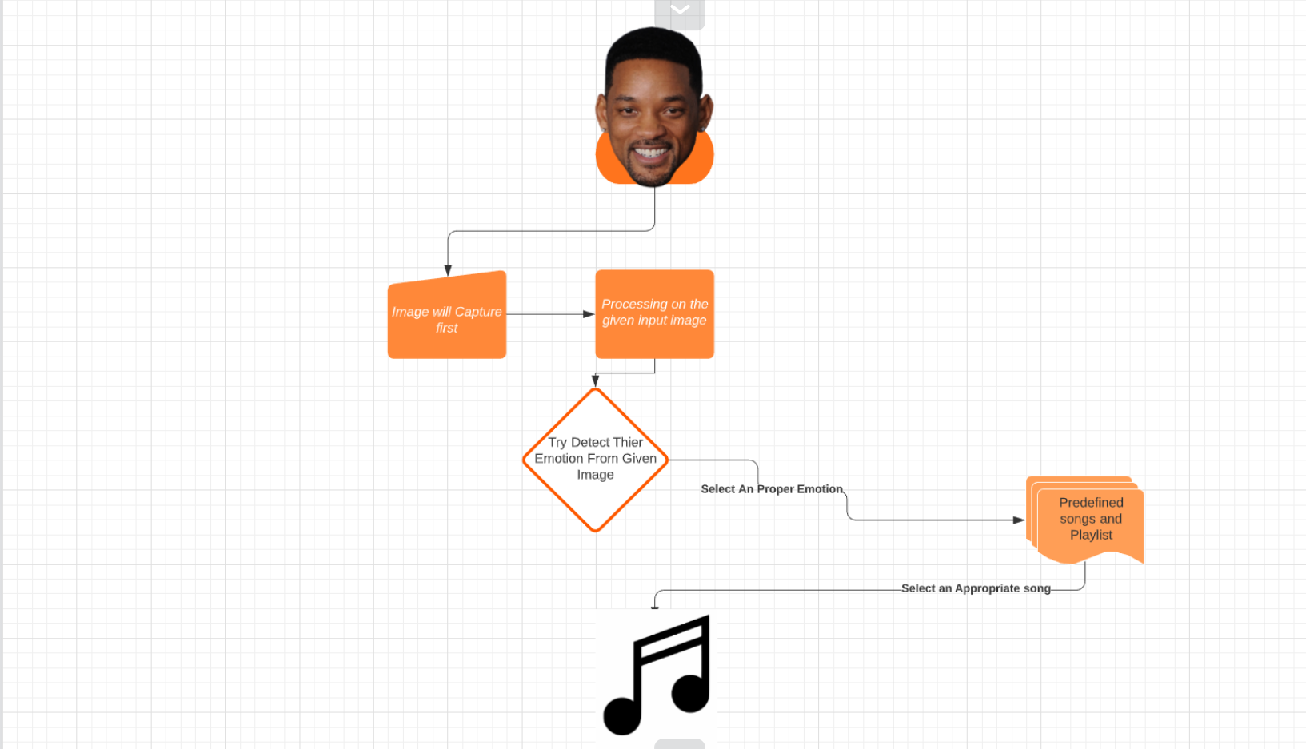
Flow Diagram
What Is a Library ?
1
22

Slide 25
Use version of language and modules
Python==3.6.0
opencv-python==4.5.1.48
tensorflow==2.4.1
Keras==2.4.3
numpy==1.19.5
pandas==0.25.3
23

Slide 26
Code for face detection
from cv2 import cv2
faceCascade=cv2.CascadeClassifier('haarcascade_frontalface_default.xml')
cap=cv2.VideoCapture(0)
while True:
ret,frame=cap.read()
gray=cv2.cvtColor(frame,cv2.COLOR_BGR2GRAY)
faces=faceCascade.detectMultiScale(gray,1.1,4)
for(x,y,w,h) in faces:
cv2.rectangle(frame,(x,y),(x+w,y+h),(0,0,255),4)
cv2.imshow('demo video',frame)
if cv2.waitKey(1)& 0xFF== ord('q'):
break
cap.release()
cv2.destroyAllWindows()
24

Slide 27
Code for training model
import pandas as pd
import numpy as np
from keras.models import Sequential
from keras.layers import Dense, Dropout,Flatten
from keras.layers import Conv2D, MaxPooling2D
from keras.losses import categorical_crossentropy
from keras.optimizers import Adam
from keras.utils import np_utils
df=pd.read_csv('fer2013.csv')
# print(df.head())
X_train,train_y,X_test,test_y=[],[],[],[]
for index, row in df.iterrows():
val=row['pixels'].split(" ")
try:
if 'Training' in row['Usage']:
X_train.append(np.array(val,'float32'))
train_y.append(row['emotion'])
elif 'PublicTest' in row['Usage']:
X_test.append(np.array(val,'float32'))
test_y.append(row['emotion'])
except:
print(f"error occured at index :{index} and row:{row}”)
num_features = 64
num_labels = 7
batch_size = 64
epochs = 30
width, height = 48, 48
25

Slide 28
Conti..
Code for training model
X_train = np.array(X_train,'float32')
train_y = np.array(train_y,'float32')
X_test = np.array(X_test,'float32')
test_y = np.array(test_y,'float32')
train_y=np_utils.to_categorical(train_y, num_classes=num_labels)
test_y=np_utils.to_categorical(test_y, num_classes=num_labels)
#cannot produce
#normalizing data between oand 1
X_train -= np.mean(X_train, axis=0)
X_train /= np.std(X_train, axis=0)
X_test -= np.mean(X_test, axis=0)
X_test /= np.std(X_test, axis=0)
X_train = X_train.reshape(X_train.shape[0], 48, 48, 1)
X_test = X_test.reshape(X_test.shape[0], 48, 48, 1)
model = Sequential() model.add(Conv2D(64, kernel_size=(3, 3), activation='relu', input_shape=(X_train.shape[1:])))
26

Slide 29
Conti..
Code for training model
model.add(Conv2D(64,kernel_size= (3, 3), activation='relu'))
# model.add(BatchNormalization())
model.add(MaxPooling2D(pool_size=(2,2), strides=(2, 2)))
model.add(Dropout(0.5))
#2nd convolution layer
model.add(Conv2D(64, (3, 3), activation='relu'))
model.add(Conv2D(64, (3, 3), activation='relu'))
# model.add(BatchNormalization())
model.add(MaxPooling2D(pool_size=(2,2), strides=(2, 2)))
model.add(Dropout(0.5))
#3rd convolution layer
model.add(Conv2D(128, (3, 3), activation='relu'))
model.add(Conv2D(128, (3, 3), activation='relu'))
# model.add(BatchNormalization())
model.add(MaxPooling2D(pool_size=(2,2), strides=(2, 2)))
model.add(Flatten())
#fully connected neural networks
model.add(Dense(1024, activation='relu'))
model.add(Dropout(0.2))
model.add(Dense(1024, activation='relu'))
model.add(Dropout(0.2))
27

Slide 30
Conti..
Code for training model
model.add(Dense(num_labels, activation='softmax'))
# model.summary()
#Compliling the model
model.compile(loss=categorical_crossentropy,
optimizer=Adam(),
metrics=['accuracy'])
#Training the model
model.fit(X_train, train_y,
batch_size=batch_size,
epochs=epochs,
verbose=1,
validation_data=(X_test, test_y),
shuffle=True)
#Saving the model to use it later on
fer_json = model.to_json()
with open("fer.json", "w") as json_file:
json_file.write(fer_json)
model.save_weights("fer.h5")
28

Slide 31
Code for storing model information(Json File)
(Auto generated Code)
Code for training model
{"class_name": "Sequential", "config": {"name": "sequential", "layers": [{"class_name": "InputLayer", "config": {"batch_input_shape": [null, 48, 48, 1], "dtype": "float32", "sparse": false, "ragged": false, "name": "conv2d_input"}}, {"class_name": "Conv2D", "config": {"name": "conv2d", "trainable": true, "batch_input_shape": [null, 48, 48, 1], "dtype": "float32", "filters": 64, "kernel_size": [3, 3], "strides": [1, 1], "padding": "valid", "data_format": "channels_last", "dilation_rate": [1, 1], "groups": 1, "activation": "relu", "use_bias": true, "kernel_initializer": {"class_name": "GlorotUniform", "config": {"seed": null}}, "bias_initializer": {"class_name": "Zeros", "config": {}}, "kernel_regularizer": null, "bias_regularizer": null, "activity_regularizer": null, "kernel_constraint": null, "bias_constraint": null}}, {"class_name": "Conv2D", "config": {"name": "conv2d_1", "trainable": true, "dtype": "float32", "filters": 64, "kernel_size": [3, 3], "strides": [1, 1], "padding": "valid", "data_format": "channels_last", "dilation_rate": [1, 1], "groups": 1, "activation": "relu", "use_bias": true, "kernel_initializer": {"class_name": "GlorotUniform", "config": {"seed": null}}, "bias_initializer": {"class_name": "Zeros", "config": {}}, "kernel_regularizer": null, "bias_regularizer": null, "activity_regularizer": null, "kernel_constraint": null, "bias_constraint": null}}, {"class_name": "MaxPooling2D", "config": {"name": "max_pooling2d", "trainable": true, "dtype": "float32", "pool_size": [2, 2], "padding": "valid", "strides": [2, 2], "data_format": "channels_last"}}, {"class_name": "Dropout", "config": {"name": "dropout", "trainable": true, "dtype": "float32", "rate": 0.5, "noise_shape": null, "seed": null}}, {"class_name": "Conv2D", "config": {"name": "conv2d_2", "trainable": true, "dtype": "float32", "filters": 64, "kernel_size": [3, 3], "strides": [1, 1], "padding": "valid", "data_format": "channels_last", "dilation_rate": [1, 1], "groups": 1, "activation": "relu", "use_bias": true, "kernel_initializer": {"class_name": "GlorotUniform", "config": {"seed": null}}, "bias_initializer": {"class_name": "Zeros", "config": {}}, "kernel_regularizer": null, "bias_regularizer": null, "activity_regularizer": null, "kernel_constraint": null, "bias_constraint": null}}, {"class_name": "Conv2D", "config": {"name": "conv2d_3", "trainable": true, "dtype": "float32", "filters": 64, "kernel_size": [3, 3], "strides": [1, 1], "padding": "valid", "data_format": "channels_last", "dilation_rate": [1, 1], "groups": 1, "activation": "relu", "use_bias": true, "kernel_initializer": {"class_name": "GlorotUniform", "config": {"seed": null}}, "bias_initializer": {"class_name": "Zeros", "config": {}}, "kernel_regularizer": null, "bias_regularizer": null, "activity_regularizer": null, "kernel_constraint": null, "bias_constraint": null}}, {"class_name": "MaxPooling2D", "config": {"name": "max_pooling2d_1", "trainable":
29

Slide 32
Conti..
Code for training model
"channels_last"}}, {"class_name": "Dropout", "config": {"name": "dropout_1", "trainable": true, "dtype": "float32", "rate": 0.5, "noise_shape": null, "seed": null}}, {"class_name": "Conv2D", "config": {"name": "conv2d_4", "trainable": true, "dtype": "float32", "filters": 128, "kernel_size": [3, 3], "strides": [1, 1], "padding": "valid", "data_format": "channels_last", "dilation_rate": [1, 1], "groups": 1, "activation": "relu", "use_bias": true, "kernel_initializer": {"class_name": "GlorotUniform", "config": {"seed": null}}, "bias_initializer": {"class_name": "Zeros", "config": {}}, "kernel_regularizer": null, "bias_regularizer": null, "activity_regularizer": null, "kernel_constraint": null, "bias_constraint": null}}, {"class_name": "Conv2D", "config": {"name": "conv2d_5", "trainable": true, "dtype": "float32", "filters": 128, "kernel_size": [3, 3], "strides": [1, 1], "padding": "valid", "data_format": "channels_last", "dilation_rate": [1, 1], "groups": 1, "activation": "relu", "use_bias": true, "kernel_initializer": {"class_name": "GlorotUniform", "config": {"seed": null}}, "bias_initializer": {"class_name": "Zeros", "config": {}}, "kernel_regularizer": null, "bias_regularizer": null, "activity_regularizer": null, "kernel_constraint": null, "bias_constraint": null}}, {"class_name": "MaxPooling2D", "config": {"name": "max_pooling2d_2", "trainable": true, "dtype": "float32", "pool_size": [2, 2], "padding": "valid", "strides": [2, 2], "data_format": "channels_last"}}, {"class_name": "Flatten", "config": {"name": "flatten", "trainable": true, "dtype": "float32", "data_format": "channels_last"}}, {"class_name": "Dense", "config": {"name": "dense", "trainable": true, "dtype": "float32", "units": 1024, "activation": "relu", "use_bias": true, "kernel_initializer": {"class_name": "GlorotUniform", "config": {"seed": null}}, "bias_initializer": {"class_name": "Zeros", "config": {}}, "kernel_regularizer": null, "bias_regularizer": null, "activity_regularizer": null, "kernel_constraint": null, "bias_constraint": null}}, {"class_name": "Dropout", "config": {"name": "dropout_2", "trainable": true, "dtype": "float32", "rate": 0.2, "noise_shape": null, "seed": null}}, {"class_name": "Dense", "config": {"name": "dense_1", "trainable
30

Slide 33
Conti..
Code for training model
true, "dtype": "float32", "pool_size": [2, 2], "padding": "valid", "strides": [2, 2], "data_format":": true, "dtype": "float32", "units": 1024, "activation": "relu", "use_bias": true, "kernel_initializer": {"class_name": "GlorotUniform", "config": {"seed": null}}, "bias_initializer": {"class_name": "Zeros", "config": {}}, "kernel_regularizer": null, "bias_regularizer": null, "activity_regularizer": null, "kernel_constraint": null, "bias_constraint": null}}, {"class_name": "Dropout", "config": {"name": "dropout_3", "trainable": true, "dtype": "float32", "rate": 0.2, "noise_shape": null, "seed": null}}, {"class_name": "Dense", "config": {"name": "dense_2", "trainable": true, "dtype": "float32", "units": 7, "activation": "softmax", "use_bias": true, "kernel_initializer": {"class_name": "GlorotUniform", "config": {"seed": null}}, "bias_initializer": {"class_name": "Zeros", "config": {}}, "kernel_regularizer": null, "bias_regularizer": null, "activity_regularizer": null, "kernel_constraint": null, "bias_constraint": null}}]}, "keras_version": "2.4.0", "backend": "tensorflow"}
31

Slide 34
Code for Emotion Recognition
Code for training model
from cv2 import cv2
import os
import numpy as np
from keras.models import model_from_json
from keras.preprocessing import image
import time
import random
model = model_from_json(open("fer.json", "r").read()) model.load_weights('fer.h5’)
face_haar_cascade = cv2.CascadeClassifier('haarcascade_frontalface_default.xml')
cap=cv2.VideoCapture(0)
now = time.time()
future = now + 15
while True:
ret,test_img=cap.read()
test_img=cv2.flip(test_img,1,0)
if not ret:
continue
gray_img= cv2.cvtColor(test_img, cv2.COLOR_BGR2GRAY)
faces_detected = face_haar_cascade.detectMultiScale(gray_img, 1.32, 5)
32

Slide 35
Conti..
Code for training model
for (x,y,w,h) in faces_detected:
cv2.rectangle(test_img,(x,y),(x+w,y+h),(255,0,0),thickness=7)
roi_gray=gray_img[y:y+w,x:x+h]
roi_gray=cv2.resize(roi_gray,(48,48))
img_pixels = image.img_to_array(roi_gray)
img_pixels = np.expand_dims(img_pixels, axis = 0)
img_pixels /= 255
predictions = model.predict(img_pixels)
max_index = np.argmax(predictions[0])
emotions = ('angry', 'disgust', 'fear', 'happy', 'sad','surprise','neutral')
predicted_emotion = emotions[max_index]
cv2.putText(test_img, predicted_emotion, (int(x), int(y)), cv2.FONT_HERSHEY_SIMPLEX, 1, (0,0,255), 2)
resized_img = cv2.resize(test_img, (1000, 700))
cv2.imshow('Main Window ',resized_img)
key = cv2.waitKey(30)& 0xff
33

Slide 36
Code for Music Linking
Code for training model
if time.time() > future:
try:
cv2.destroyAllWindows()
cap.release()
if predicted_emotion == "happy":
mc= ['F:\\Final year project\\song\\HAPPY1.mp3','F:\\Final year project\\song\\HAPPY2.mp3','F:\\Final year project\\song\\HAPPY3.mp3','F:\\Final year project\\song\\HAPPY4.mp3','F:\\Final year project\\song\\HAPPY5.mp3']
pm=random.choice(mc)
os.startfile(pm)
if predicted_emotion == "sad":
mc= ['F:\\Final year project\\song\\sad1.mp3','F:\\Final year project\\song\\sad2.mp3','F:\\Final year project\\song\\sad3.mp3','F:\\Final year project\\song\\sad4.mp3','F:\\Final year project\\song\\sad5.mp3','F:\\Final year project\\song\\sad6.mp3','F:\\Final year project\\song\\sad7.mp3']
pm=random.choice(mc)
os.startfile(pm)
if predicted_emotion == "fear":
mc=['F:\\Final year project\\song\\fear1.mp3']
pm=random.choice(mc)
os.startfile(pm)
Break
except:
print('Please stay focus in Camera frame atleast 15 seconds & run again this program:)')
Break if key == 27: break
34

Slide 37
Test Case
Code for training model
Test Case Id | Description | Expected Result | Actual Result | Status
001 | To check whether the camera is open or not | After user execute the program camera will successfully open | Camera is successfully open | Pass
002 | To check whether the camera is open or not | After user execute the program camera will successfully open | Camera is not opening | Fail
003 | To check whether the camera is lagging or not | After opening the camera, camera will open smoothly | Camera is successfully open and runs smoothly | Pass
004 | To check whether the camera is lagging or not | After opening the camera, camera will open smoothly | Camera is successfully open but after opening the camera, camera is to lagging | Fail
35

Slide 38
Conti..
Code for training model
Test Case Id | Description | Expected Result | Actual Result | Status
005 | To check whether the face is detected or not | After opening the camera and after detecting the face there should get square around users face | Camera will open without any lagging and detect face properly with draw the rectangle in user face | Pass
006 | Detect faces | After opening the camera there will be some obstacles Infront of users face the system does not recognize the users face | After getting obstacles Infront of camera system does not recognize users face | Pass
007 | To check whether the face is detected or not | After opening the camera and after detecting the face there should get square around users face | Camera will open without any lagging but its fail to draw the rectangle in to the user face | Fail
36

Slide 39
Conti..
Code for training model
Test Case Id | Description | Expected Result | Actual Result | Status
008 | Passing happy image as a input to system | After successfully detect the face system will detect correct emotion. | System will detect Correct emotion as per giving input | Pass
009 | Passing happy image as a input to system | After successfully detect the face system will detect correct emotion. | System will detect the face but its predict the emotion wrong | Fail
010 | Saving songs into the folder | Songs will be adding to the specific folder | Song is added successfully | Pass
37

Slide 40
Conti..
Code for training model
Test Case Id | Description | Expected Result | Actual Result | Status
011 | Close the camera window | Close the camera detection window while the specific time is given | Window will be closed while specific time is given | Pass
012 | Close the camera window | Close the camera detection window while the specific time is given. | After exhaust the specific time limit camera is still open and try to capture the image | Fail
013 | Close the camera window | After detecting the face and recognize users emotion just close the window | After detecting face and emotion still window is open and try to detect user mode | Fail
38

Slide 41
Conti..
Code for training model
Test Case Id | Description | Expected Result | Actual Result | Status
014 | Close the camera window | After detection the face and recognize users emotion just close the window | After detecting face and emotion camera will automatically get closed | Pass
015 | Play the song as per emotion | After detection emotion song will be play automatically as per the user emotion | Song is playing as per the emotion | Pass
016 | Play the song as per emotion | After detection emotion song will play automatically | After detection the emotion nothing is going to happen | Fail
39

Slide 42
Conti..
Code for training model
Test Case Id | Description | Expected Result | Actual Result | Status
017 | Play the song as per emotion | After detection emotion song will be play automatically as per the user emotion | Song is playing but not for the user emotions randomly any song is playing | Fail
018 | Close the camera window and play the song | After detecting emotion just close the camera and instantly play the song as per user mode | Camera will close while detection emotion and instantly song will be played | Pass
019 | Close the camera window and play the song | After detecting emotion just close the camera and instantly play the song as per user mode | Camera is still open after detection and song is playing and still user mode is capturing | Fail
40

Slide 43
Conti..
Code for training model
Test Case Id | Description | Expected Result | Actual Result | Status
020 | Close the window while escape or q key is pressed | After pressing q and escape button camera will close | Camera is close after pressing escape or q key | Pass
41

Slide 44
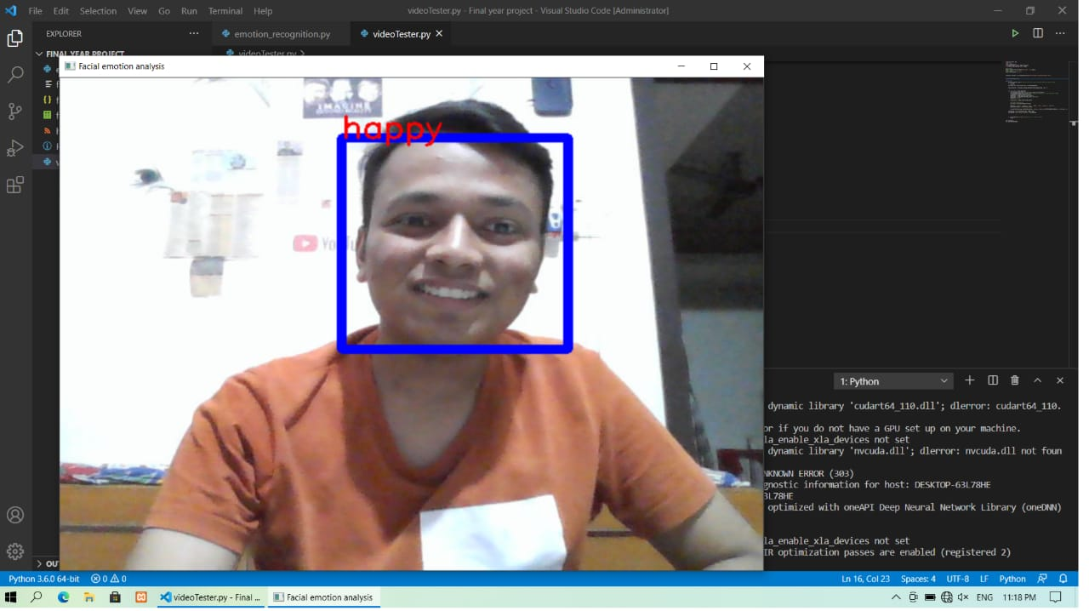
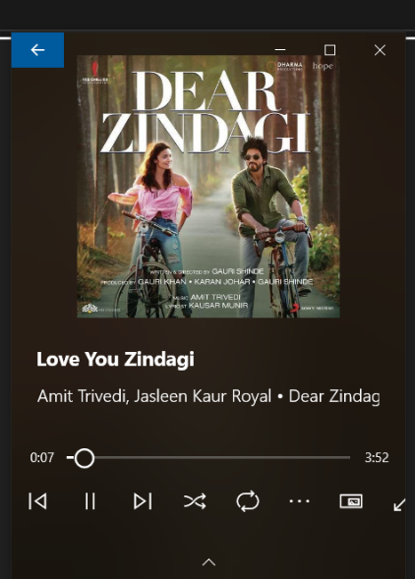
Realtime Output
Code for training model
Happy Emotion
Happy Song
42

Slide 45
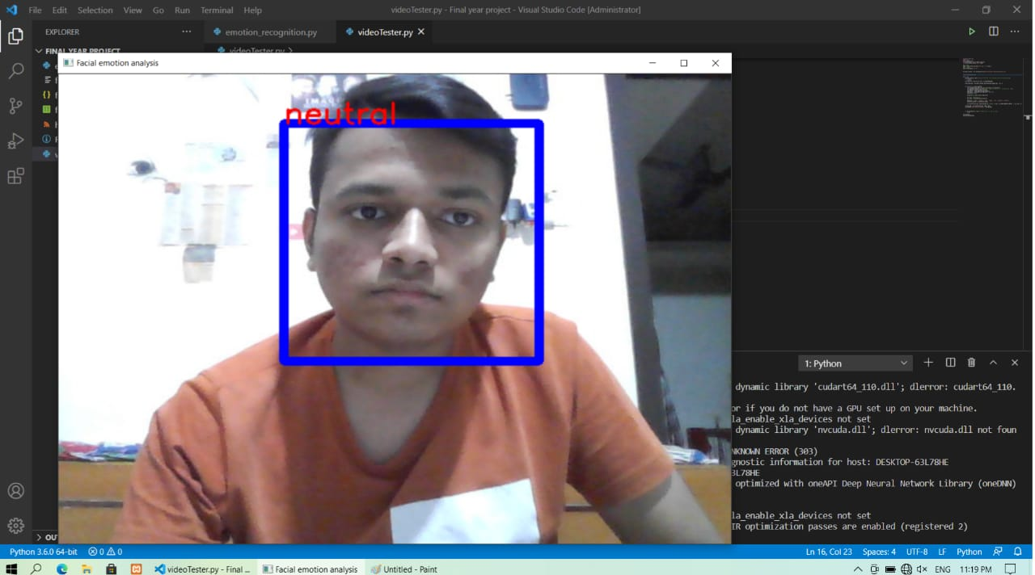
Realtime Output
Code for training model
NO SONG
Neutral Emotion
43

Slide 46
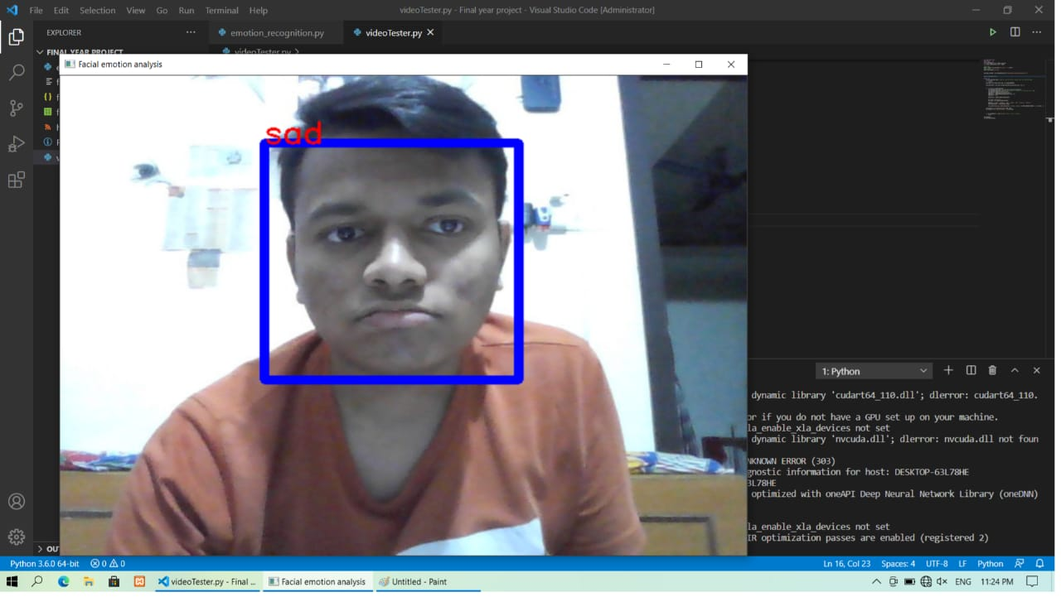
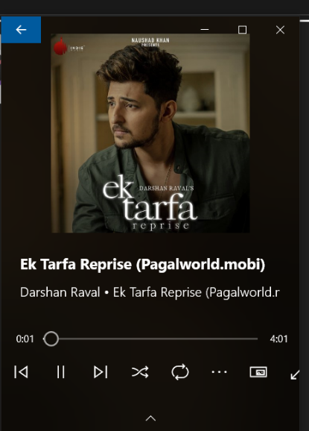
Realtime Output
Code for training model
Sad Emotion
Sad Song
44

Slide 47
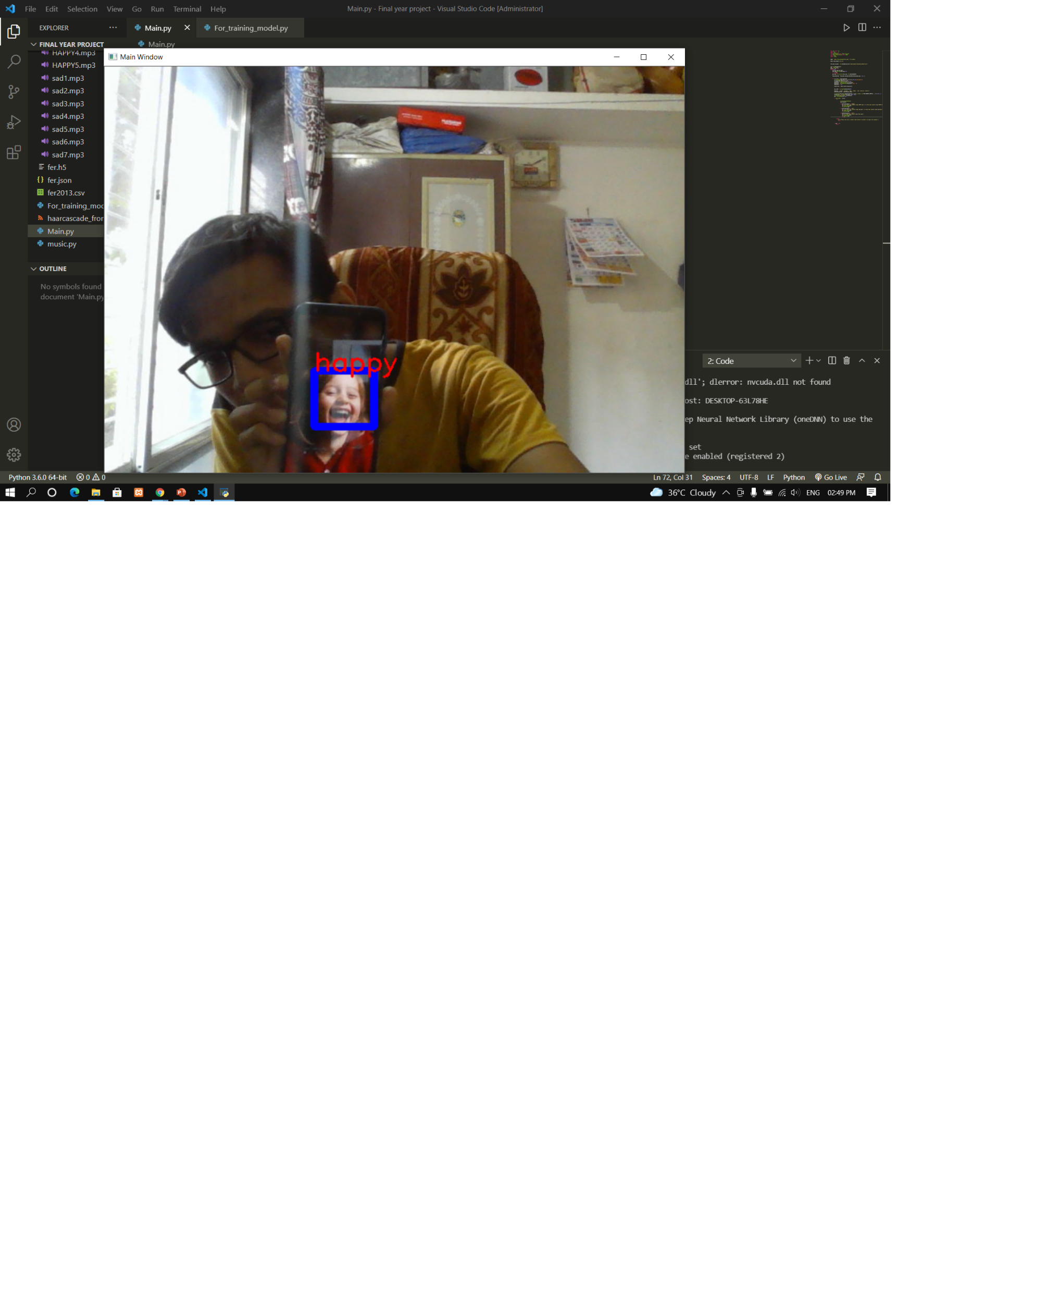
Realtime Images Output
Code for training model
Happy Emotion
45

Slide 48
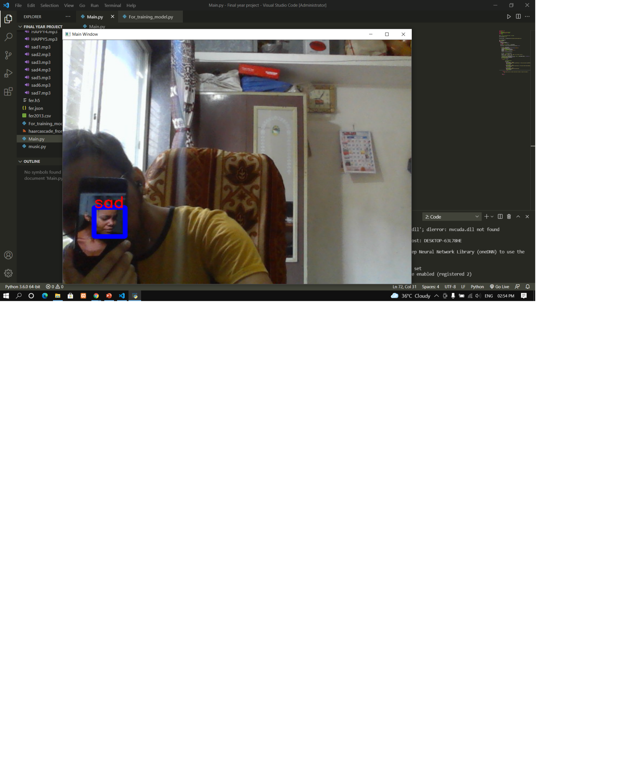
Realtime Images Output
Code for training model
Sad Emotion
46

Slide 49
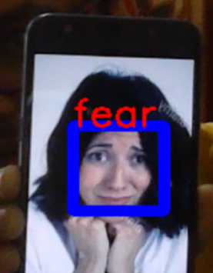
Realtime Images Output
Code for training model
Fear Emotion
47

Slide 50
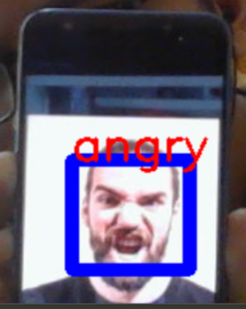
Realtime Images Output
Code for training model
Angry Emotion
48

Slide 51
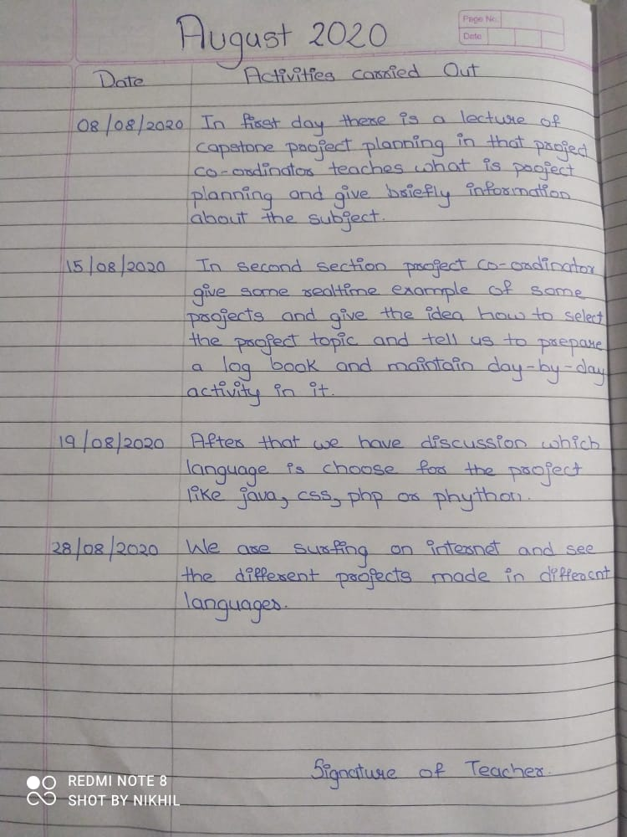
August 2020
49

Slide 52
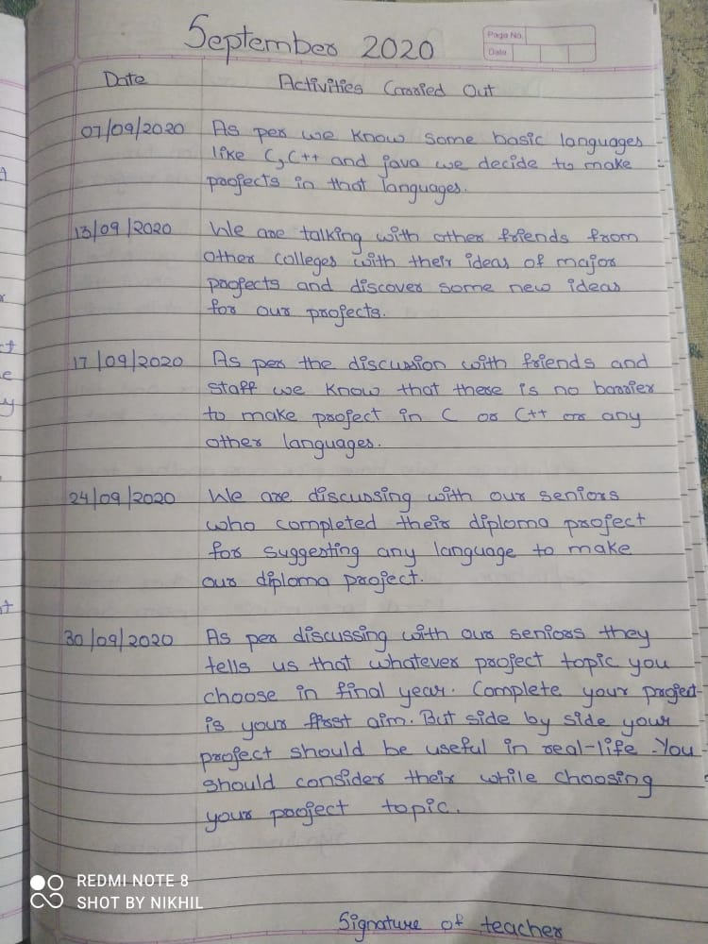
September 2020
50

Slide 53
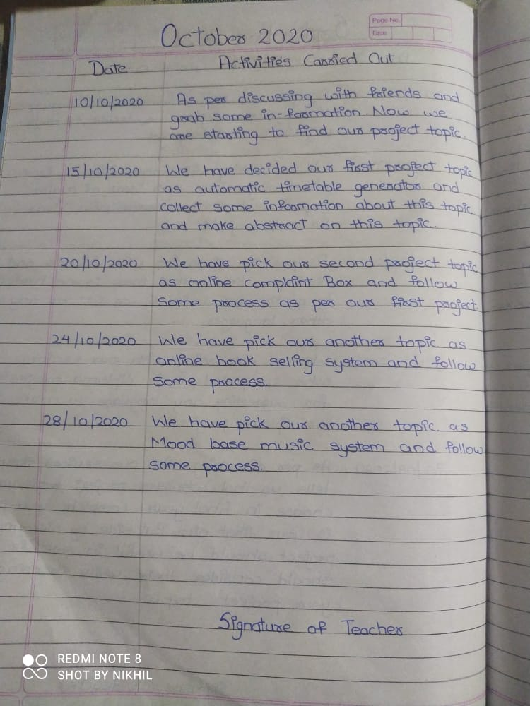
October 2020
51

Slide 54
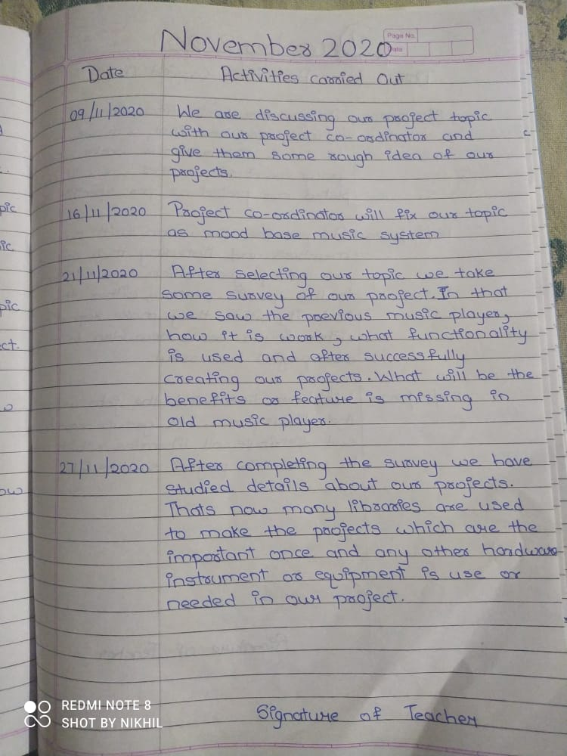
November 2020
52

Slide 55
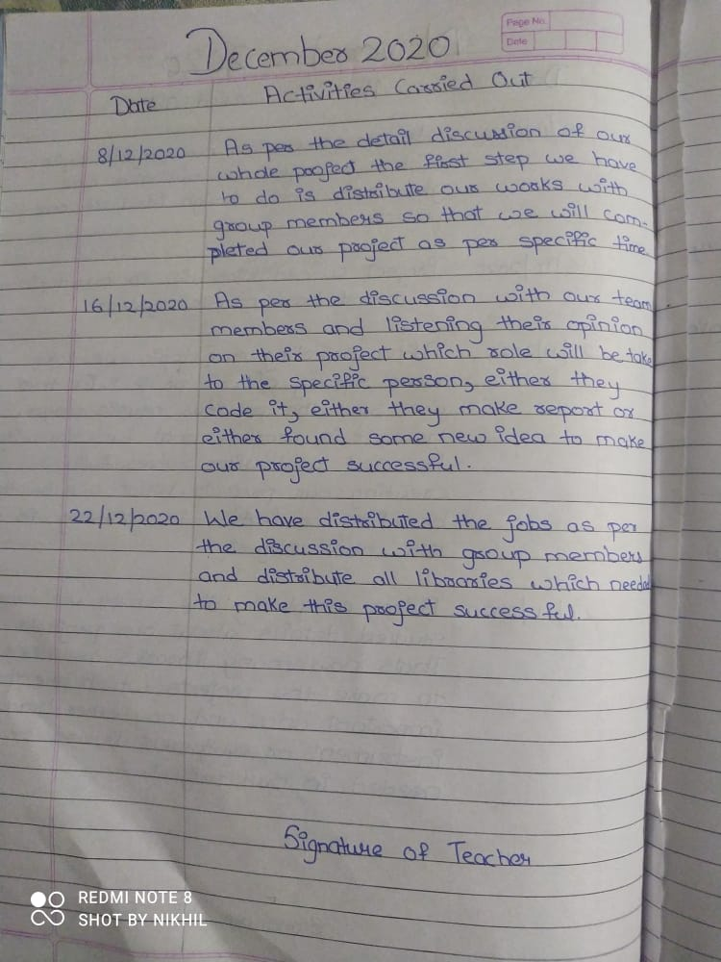
December 2020
53

Slide 56
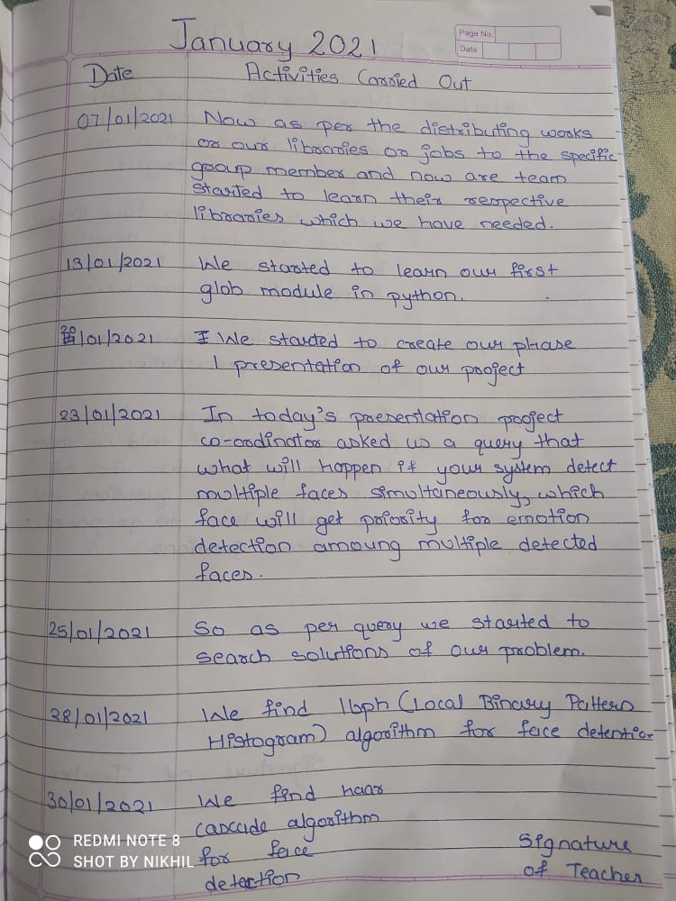
January 2021
54

Slide 57
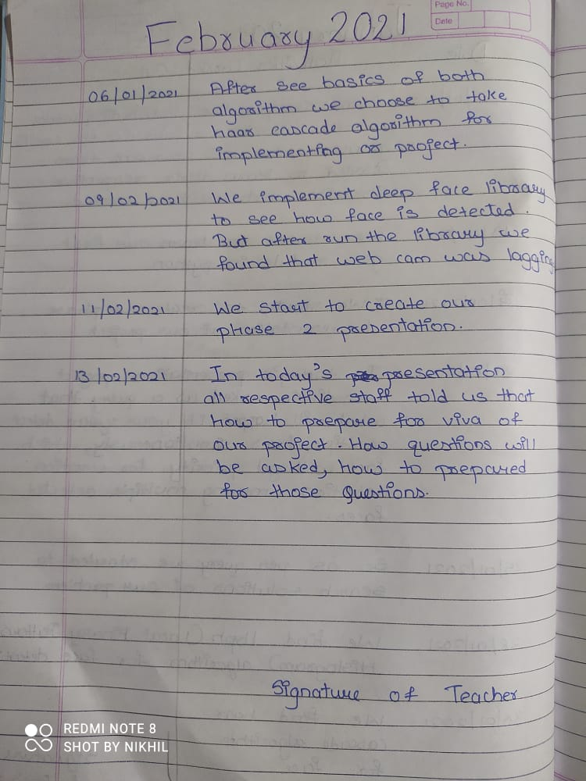
February 2021
55

Slide 58
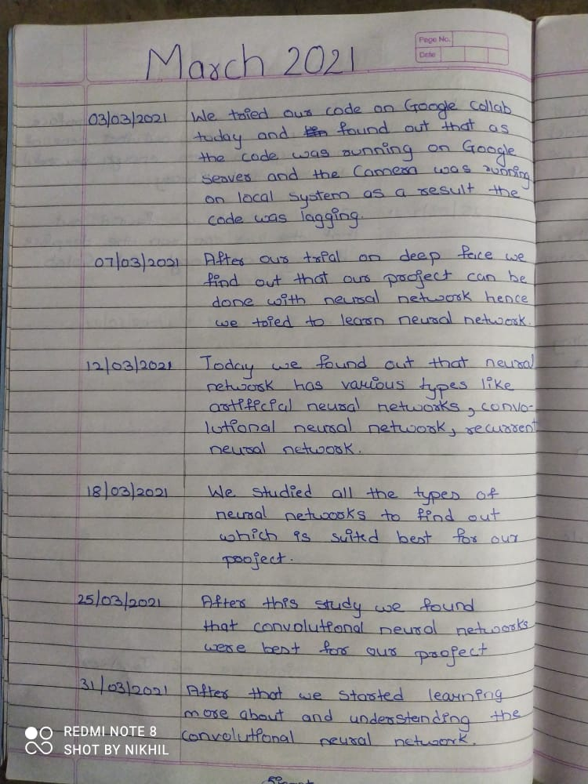
March 2021
56

Slide 59
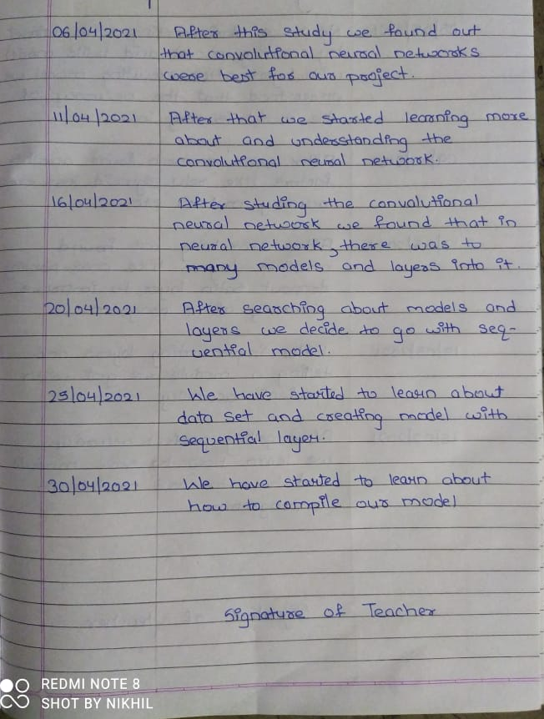
April 2021
57

Slide 60
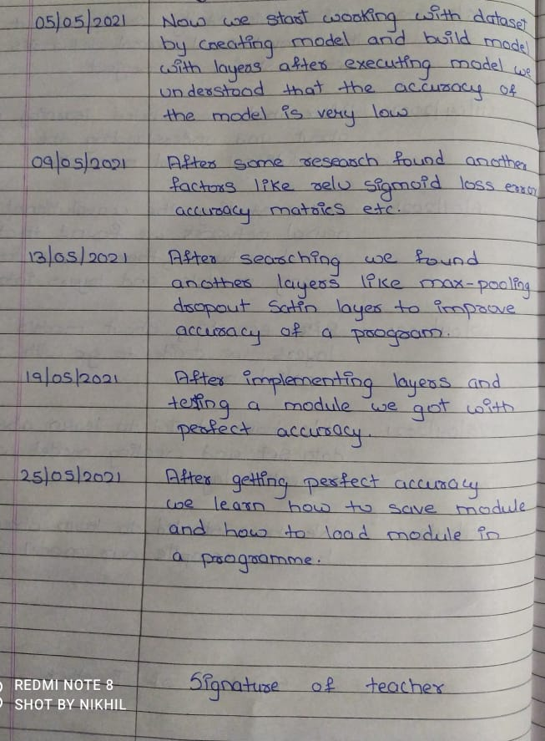
May 2021
58

Slide 61




Reference
Code for training model
Python download link:-
https://www.python.org/downloads/release/python-360/
Keras download link:-
https://pypi.org/project/keras/
TensorFlow download link:-
https://www.tensorflow.org/learn
Dataset download link:-
https://www.kaggle.com/
Opencv download link:-
https://pypi.org/project/opencv-python/
Harcascade frontal face download link:-
http://alereimondo.no-ip.org/OpenCV/34
Songs download link:-
https://www.pagalworld.pw/
59

Slide 62
conti…
[1] All music, 2017. [Online; accessed 11-July-2017].
[2] Moodfuse, 2017. [Online; accessed 11-July-2017].
[3] Saavn, 2017. [Online; accessed 11-July-2017].
[4] Steromood, 2017. [Online; accessed 11-July-2017].
[5] Viola, P., and Jones, M. Rapid object detection using a boosted
cascade of simple features. Proceedings of the 2001 IEEE
Computer Society Conference on, vol. 1, pp. 511-518
IEEE, (2001.)
60

Slide 63
Conclusion
After getting all information about our project and understanding all necessary libraries, algorithm that is useful for making our system now we are ready to implement and design our mood based music system project in upcoming semister.
61

Slide 64
Thank You...

